Slide 1
APMS
Automatic Parking Management and Parking Fee Collection System
Mentors:
Đặng Ngọc Minh Đức
Kiều Trọng Khánh
Members:
Khúc Ngọc Thái (leader)
Hồ Hữu Phát
Thủy Võ Anh Hoàng
Nguyễn Quang Dũng
Tăng Chí Cường
GFA22SE51 - FA22SE50

Slide 2
Index
01
Introduction
02
Core flows
03
System overview
Setup
04
05
Demo flows
Demonstration
06

Slide 3
01
INTRODUCTION

Slide 4
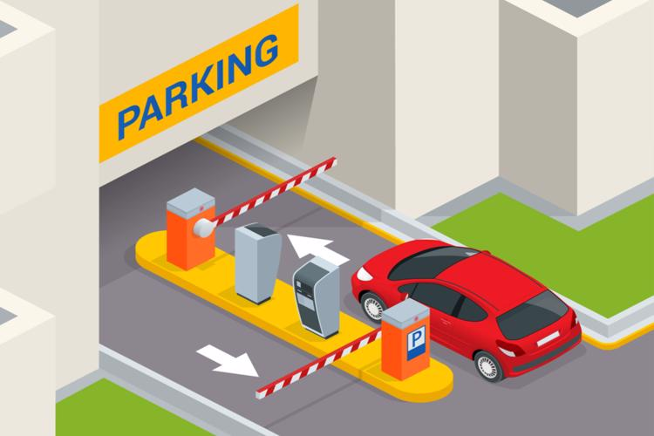
01
INTRODUCTION
This product is a C2B2C product, aims to deliver a contactless solution by automate the process of managing public car parking lots (supermarkets, parks, etc.), thus reducing the time and human resource for the parking process.
By implementing this system, owners can easily manage statistics of their parking lots, and able to customize configurations such as parking fee per hour, reservation fee, etc.
On the parking lot customer side, vehicle license plates recognition and detection will be implemented, removing the needs for other traditional methods such as RFID or tickets. Other advanced features such as find the nearest parking lot, book a slot in advance, etc. will also be included.

Slide 5
02
CORE FLOWS

Slide 6
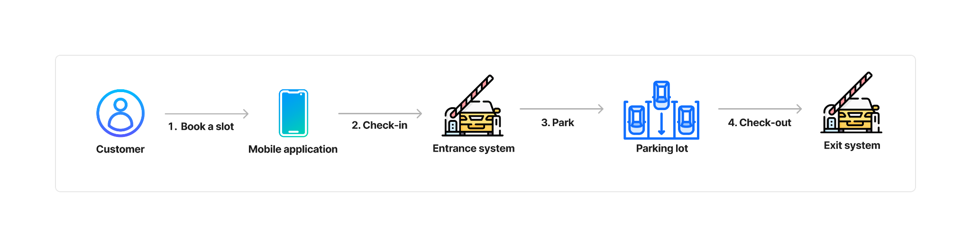
02
CORE FLOW VISUALIZATION
Figure 1: Core flow visualization of a customer booking & using a parking slot

Slide 7
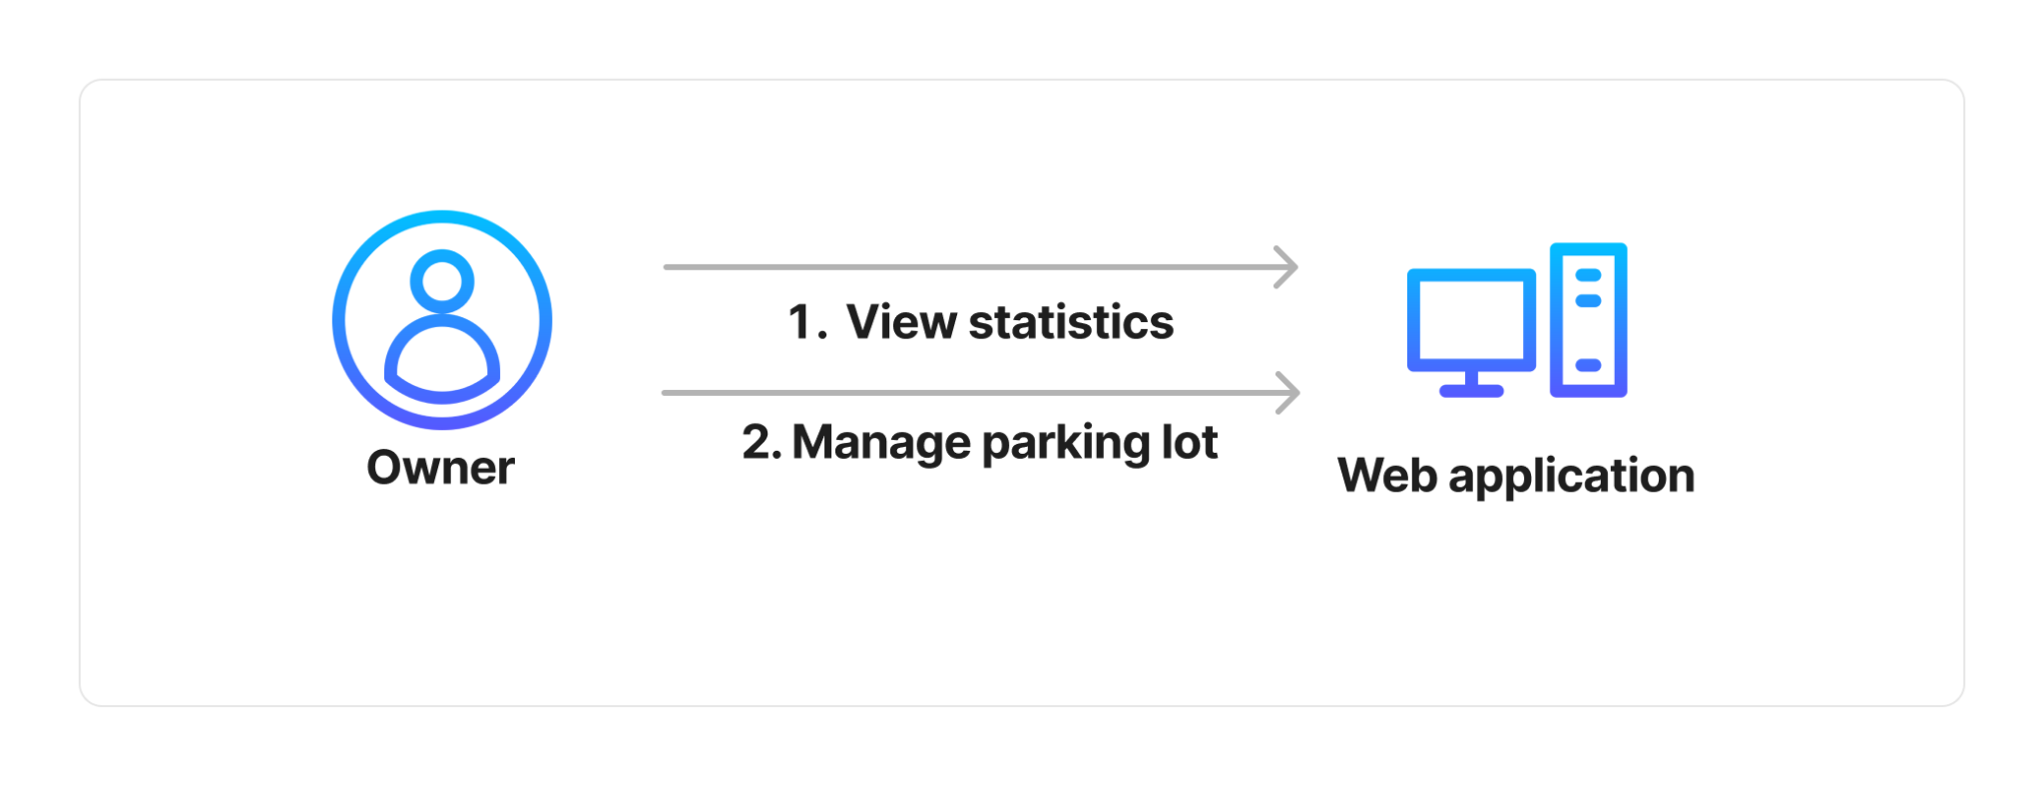
02
CORE FLOW VISUALIZATION
Figure 2: Core flow visualization of a parking lot owner using this system

Slide 8
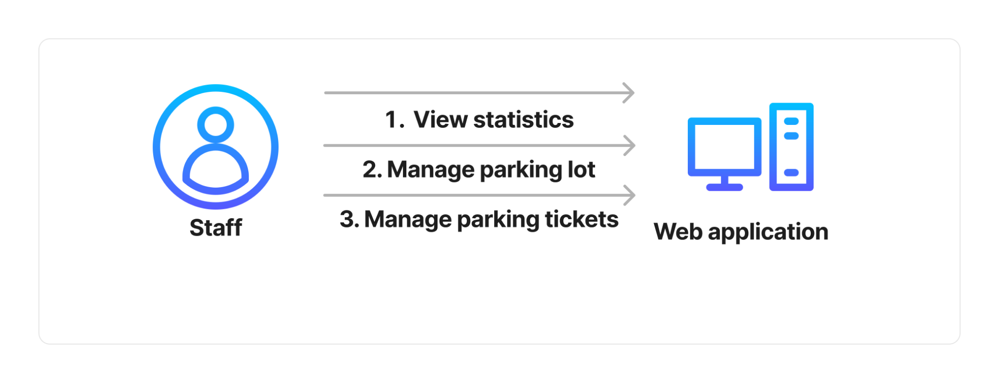
02
CORE FLOW VISUALIZATION
Figure 3: Core flow visualization of a staff working at the parking lot

Slide 9
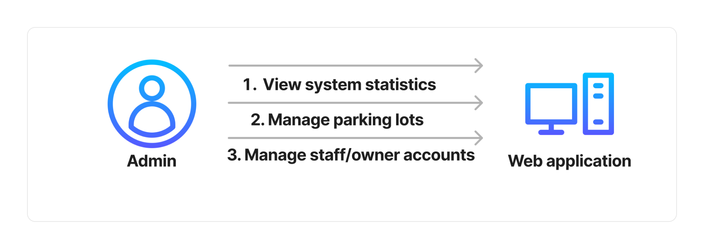
02
CORE FLOW VISUALIZATION
Figure 4: Core flow visualization of an admin

Slide 10
03
SYSTEM OVERVIEW

Slide 11
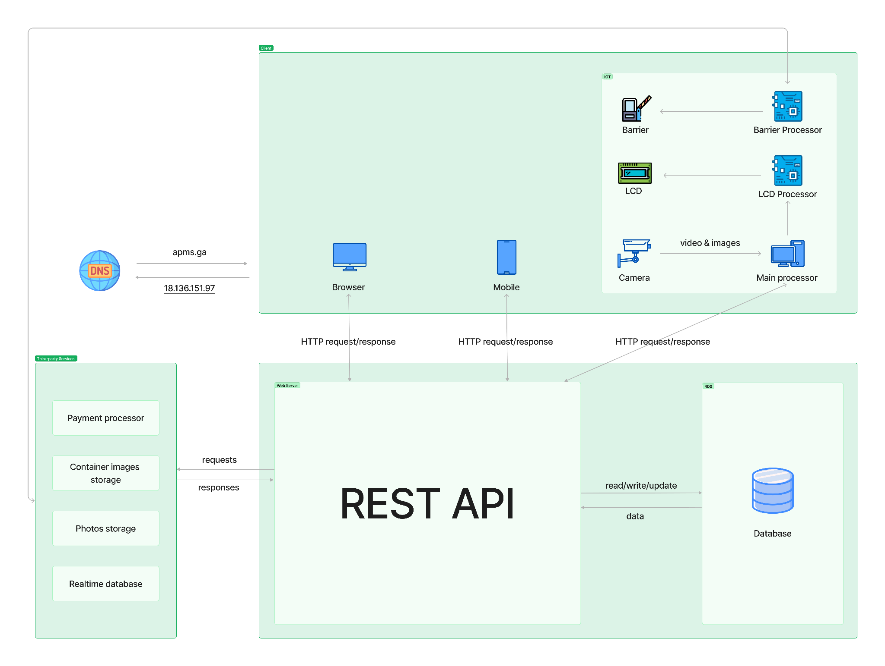
03
SYSTEM OVERVIEW
*In case the image was too small: Drive link
Figure 5: System overview diagram

Slide 12
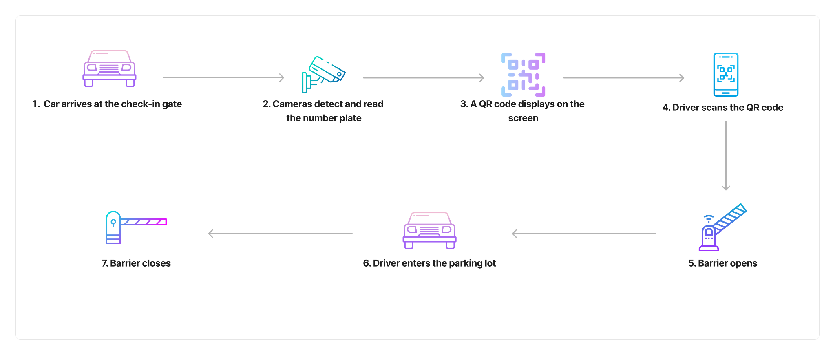
03
ENTRANCE SYSTEM
Figure 5: Entrance system workflow

Slide 13

03
EXIT SYSTEM
Figure 6: Exit system workflow

Slide 14
04
SETUP

Slide 15
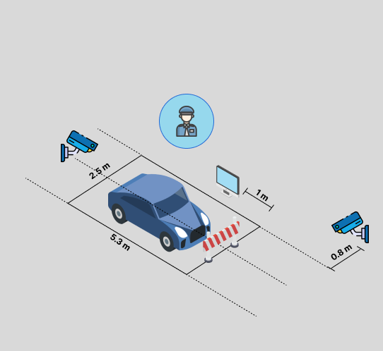
04
SETUP
Tools used in this setup:
- 2 IP KBVision cameras
- 1 Servo SG90(barrier)
- 1 LG display monitor
- 1 LCD
- 1 Arduino Uno R3
- 1 ESP32
- 1 main processor (laptop)
- Male and female wires
Setup:
- Connect display monitor to main processor via HDMI cable
- Connect Arduino UNO R3 to USB port COM8 of the main processor
- Arduino UNO R3 controls LCD via wires
- ESP32 connects to wifi itself and controls Servo
Figure 6: Setup for demonstration

Slide 16
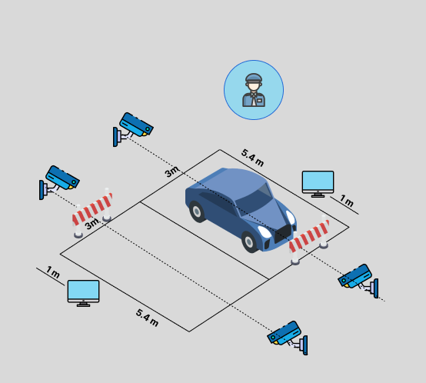
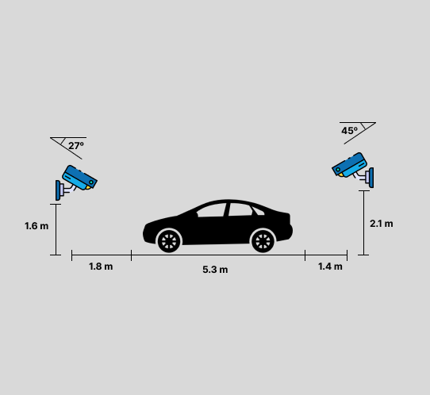
04
SETUP
Figure 8: Setup for commercial use
Figure 7: Setup for demonstration (side view)

Slide 17
05
DEMO FLOWS

Slide 18
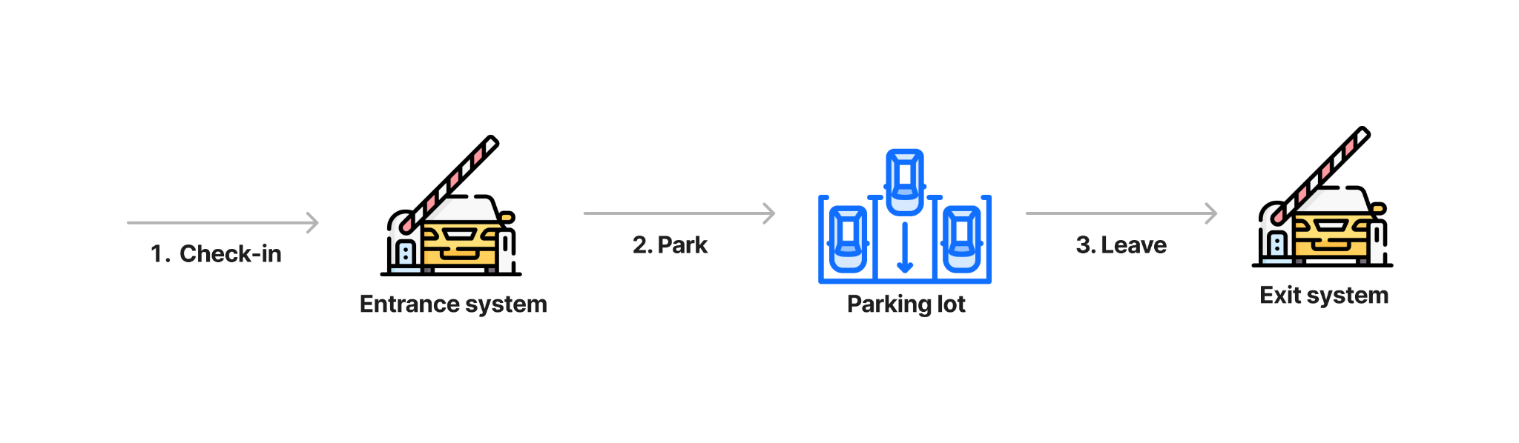
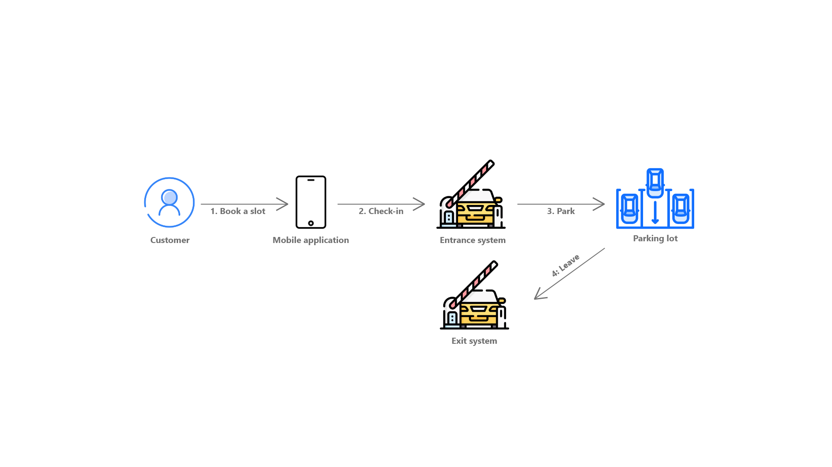
05
DEMO FLOWS
Figure 10: Demo flow visualization of a customer using the parking lot without booking in prior

Slide 19
05
DEMO FLOWS
Figure 10: Demo flow visualization of a customer booking & using a parking slot

Slide 20
06
DEMONSTRATION

Slide 21
06
DEMONSTRATION
Meet link

Slide 22
THANK YOU FOR LISTENING
Q&A

